Slide 1


Welcome back
Sue Reynolds
Elementary
Virtual Open House
Second Grade
2020-2021

Slide 2


Meet the Principal!
Donna S. Culbreath, Ed. S

Slide 3

Meet the teachers
Class webpages
N. Odom (online)-My Page
C. Grier (online)- My Page
M. Anderson- My Page
M. Eatmon- My Page
Click here for open house video

Slide 4
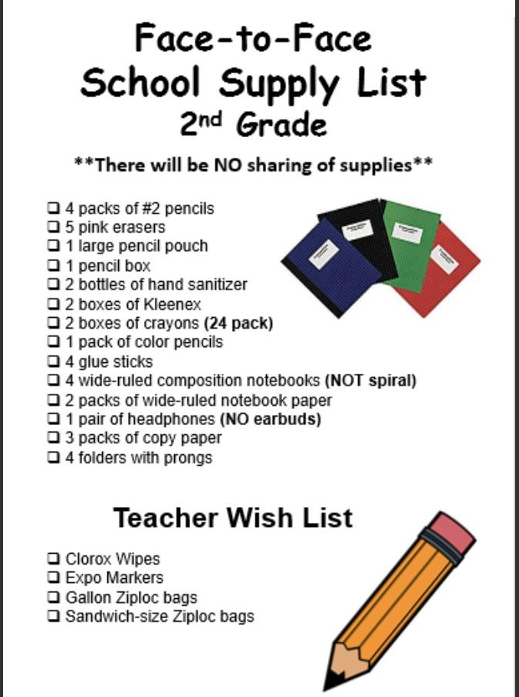
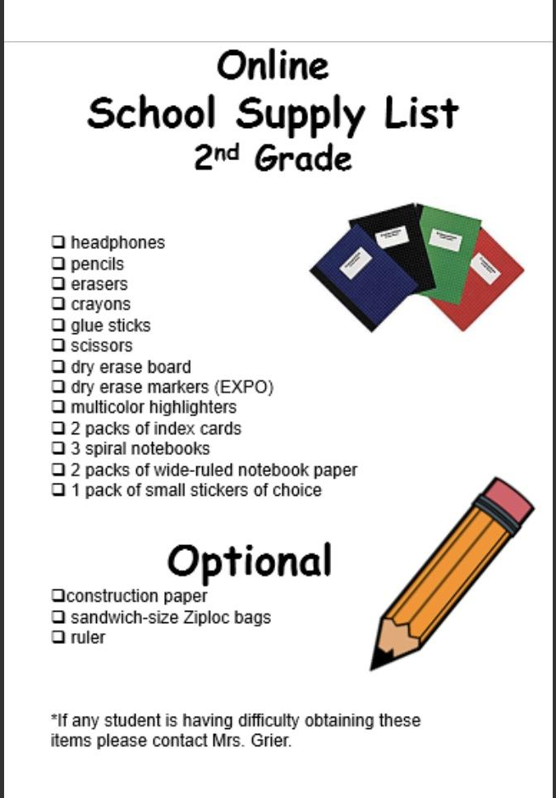

Slide 5

This year Richmond County will be using the online platform Canvas for distance learning.
Canvas can be accessed through your child’s launchpad.

Slide 6
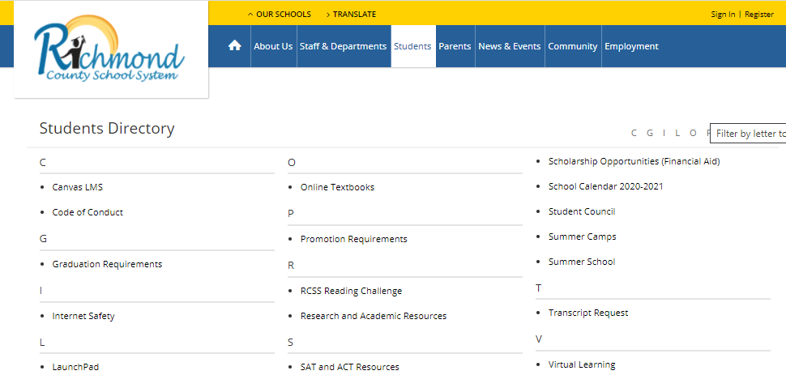
Step 1: Go to the rcboe.org page
Step 2: Click Students
Step 3: Click Launchpad
https://www.rcboe.org/

Slide 7

Step 4: Log into your computer
Step 5: Log into Launch Pad
Students will be provided their username and password!
Click here for Launchpad

Slide 8
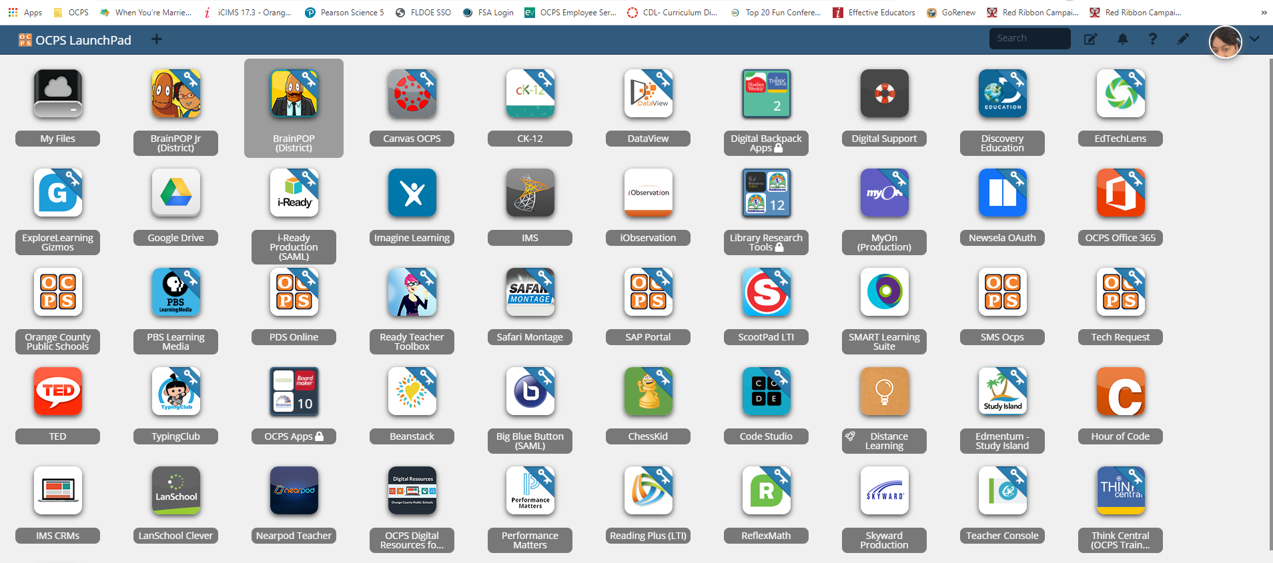
Step 6: Locate the LaunchPad app..
Every student should have preloaded apps on their dashboard.
Step 7: Click the Canvas app!

Slide 9
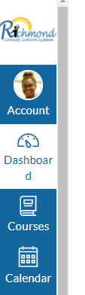
????Where is my teacher’s page????
Once you have clicked the Canvas app…
Step 1: Click Dashboard
Step 2: Find your teacher’s Course. Click on the course card.
*This could appear differently for each teacher. This is where you will begin to find all the information to move forward with your distance learning lessons.

Slide 10

Our video communication method!!!!!
Students will be able to access this through their teacher’s Canvas page.
Students can also access this through Office 365 on their LaunchPad.

Slide 11


How do parents get connected to Canvas?
https://www.rcboe.org/Page/60653

Slide 12



Sue Reynolds Remind101 Code
@93a933
Click your teachers name for the class codes
Ms. Anderson Mrs. Eatmon
Mrs. Grier
Morning
Afternoon
Mrs. Odom
Morning
Afternoon

Slide 13


All students and staff must wear a mask in the common areas of the building.
NO sharing of materials.

Slide 14
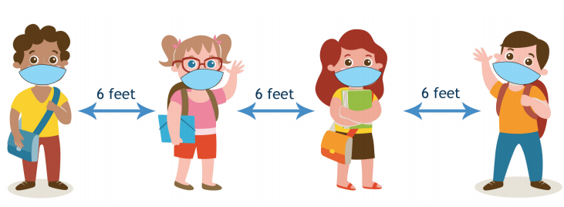
Covid -19 2nd grade Precautions
Do not send sick children to school
Monitor students frequently before arrival to school and upon returning to school.
Please communicate any concerns you may have with the teacher!
Speak to children about social distancing daily.

Slide 15
Sue Reynolds’ Elementary School day
Face-to-Face ……………………………………..8:00a.m. - 3:00 p.m.
Morning Distance Learning……………….. 9:00 a.m. - 11:00 a.m.
Afternoon Distance Learning…………....1:00 p.m. - 3:00 p.m.
Detailed distance learning schedule can be found on Mrs. Grier and Mrs. Odom’s webpage on the school website.

Slide 16

Click HERE to sign up
Parents must sign up to receive meals during distance learning.
Each meal must go to an identified student in Richmond County.
Pick up will start on Sept 4th, and resume every Friday.

Slide 17
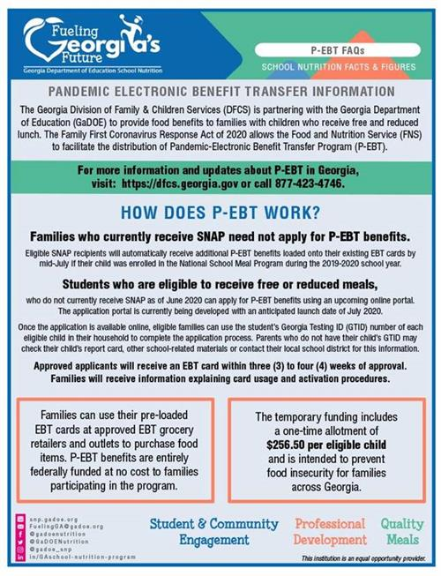
Important Information
Important Information

Slide 18
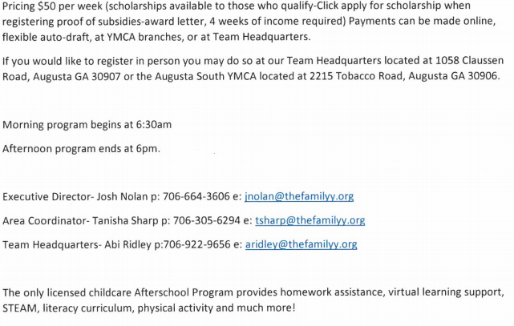
Prime Time
Register online HERE
Price $50.00
(Scholarships available)

Slide 19
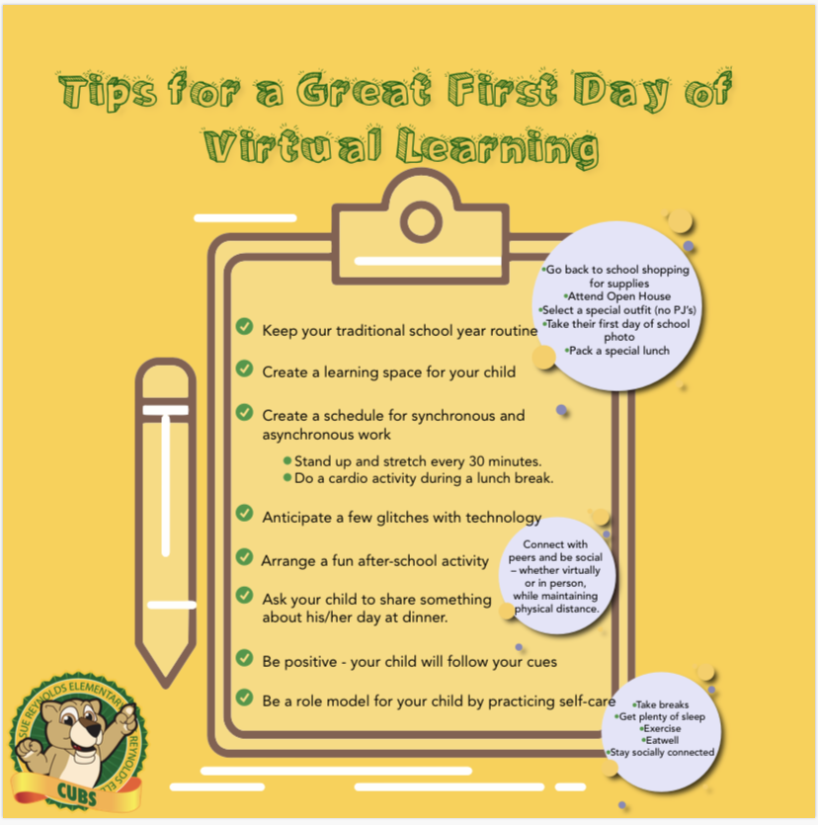
TIPS
TIPS
TIPS
TIPS
TIPS
TIPS
TIPS
TIPS

Slide 20

If you have any more questions or concerns please visit your assigned teachers webpage and contact them through their preferred contact method.
Helpful resources:
https://www.rcboe.org/site/Default.aspx?PageType=1&SiteID=4&ChannelID=70&DirectoryType=6
https://www.rcboe.org/reynolds
https://www.cdc.gov/
Tuesday morning
September 8th, 2020
At Sue Reynolds…
We are Passionate, Purposeful, Prideful in Pursuit of Learning!

